Slide 1


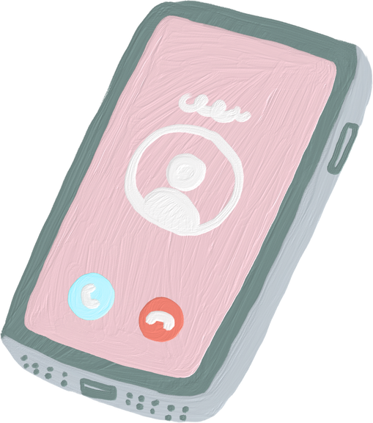




SMARTPHONE ADDICTION LEVEL
Alya Almuqren 444200610
Dana Alsalami 443200945
Aljohara Alsultan 444203635
Aljudy Altorkistani 444203157
Supervised by: Dr. Afshan Jafri

Slide 2

AGENDA
01
Introduction
05
Experiments
02
Related Works
06
Results & Discussion
03
Data
07
Conclusion
04
Method
08
Live Demo

Slide 3

INTRODUCTION
Smartphones have become an essential part of daily life, but excessive usage can lead to behavioral addiction. Smartphone addiction is associated with problems such as reduced productivity, poor sleep quality, and increased stress levels. Recent studies have explored the use of machine learning techniques to predict addiction behavior using usage-related features.
In this project, we aim to classify users into four smartphone addiction levels:
Low
Moderate
High
Severe
The project evaluates whether behavioral and demographic features can effectively distinguish between addiction categories.

Slide 4


RELATED WORKS
Study | Method | Main Finding
Lee et al. (2021) | Decision Tree, Random Forest, and XGBoost | General demographic information such as age group, job classification, and sex did not contribute much to predicting smartphone addiction level
Beluli(2023) | Supervised Classification | Structured behavioral data from mobile usage can improve addiction prediction.
Kong et al (2026) | XGBoost, SVM, Logistic Regression, KNN, Decision Tree, and Naïve Bayes | XGBoost achieved the best predictive accuracy at 92.5%, with demographic characteristics and smartphone content usage patterns

Slide 5

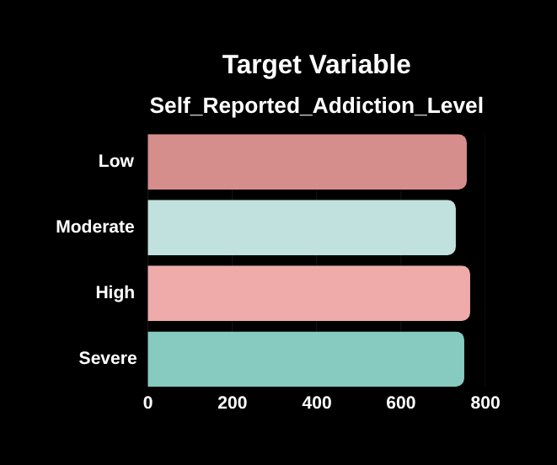

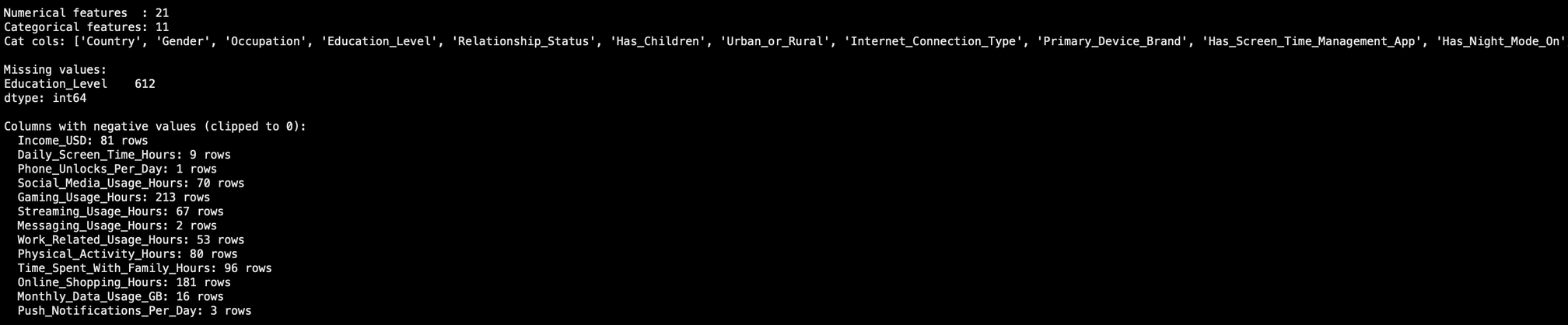
DATASET
Global Mobile Phone Addiction Dataset
Source: Kaggle
3000 user records
34 features
Multi-class classification problem
Example Features
Daily screen time
Social media usage
Sleep hours
Stress level
Phone unlocks per day
Data Quality Issues Handled:
Education_Level: 612 missing values (~20%) → imputed with mode
Multiple columns with impossible negative values → clipped to zero

Slide 6
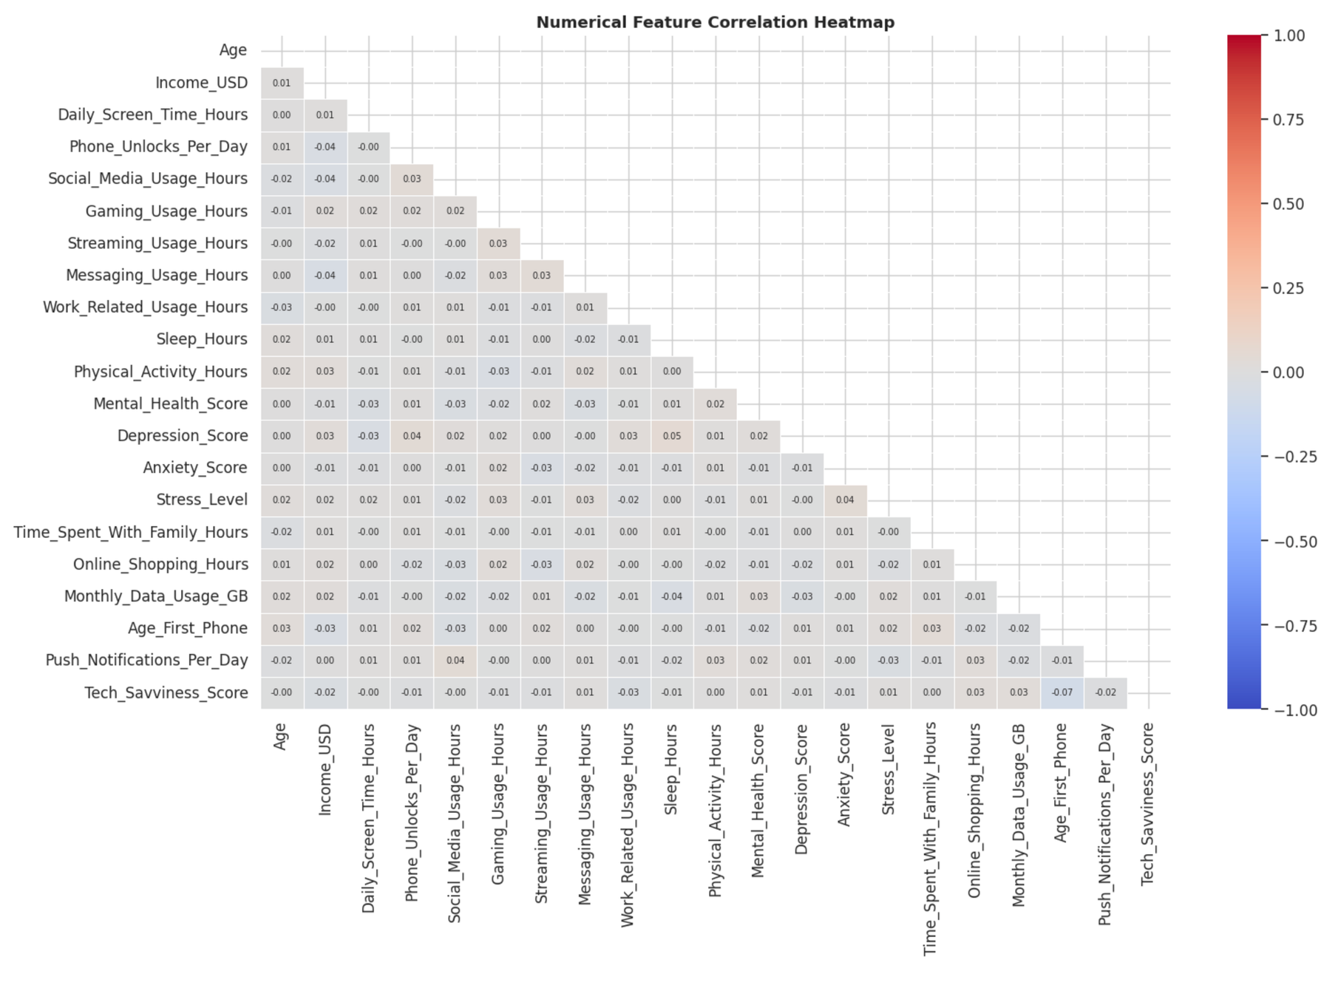
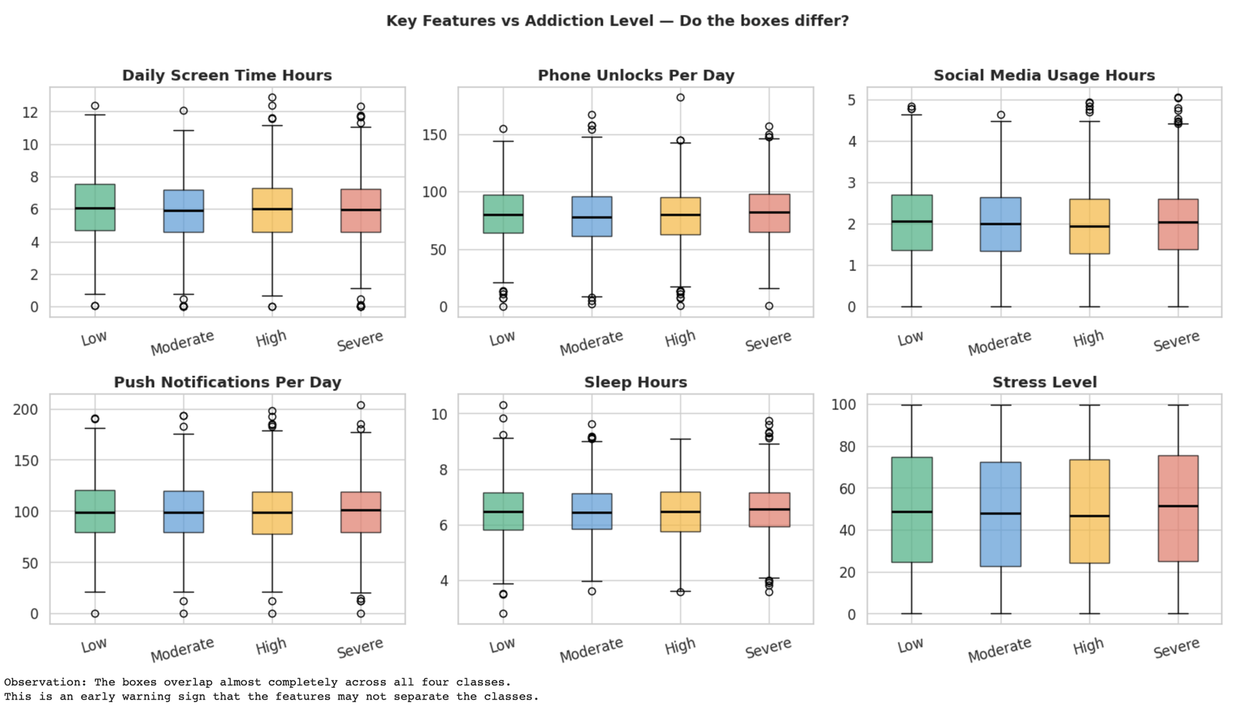
EXPLORATORY DATA ANALYSIS
Class Distribution
The dataset is approximately balanced across all four classes. Each addiction level represents around 25% of the dataset.
Feature Analysis
Boxplots were used to compare feature distributions. Correlation heatmap showed weak relationships between most numerical features.
Many features showed overlapping distributions across addiction classes.

Slide 7
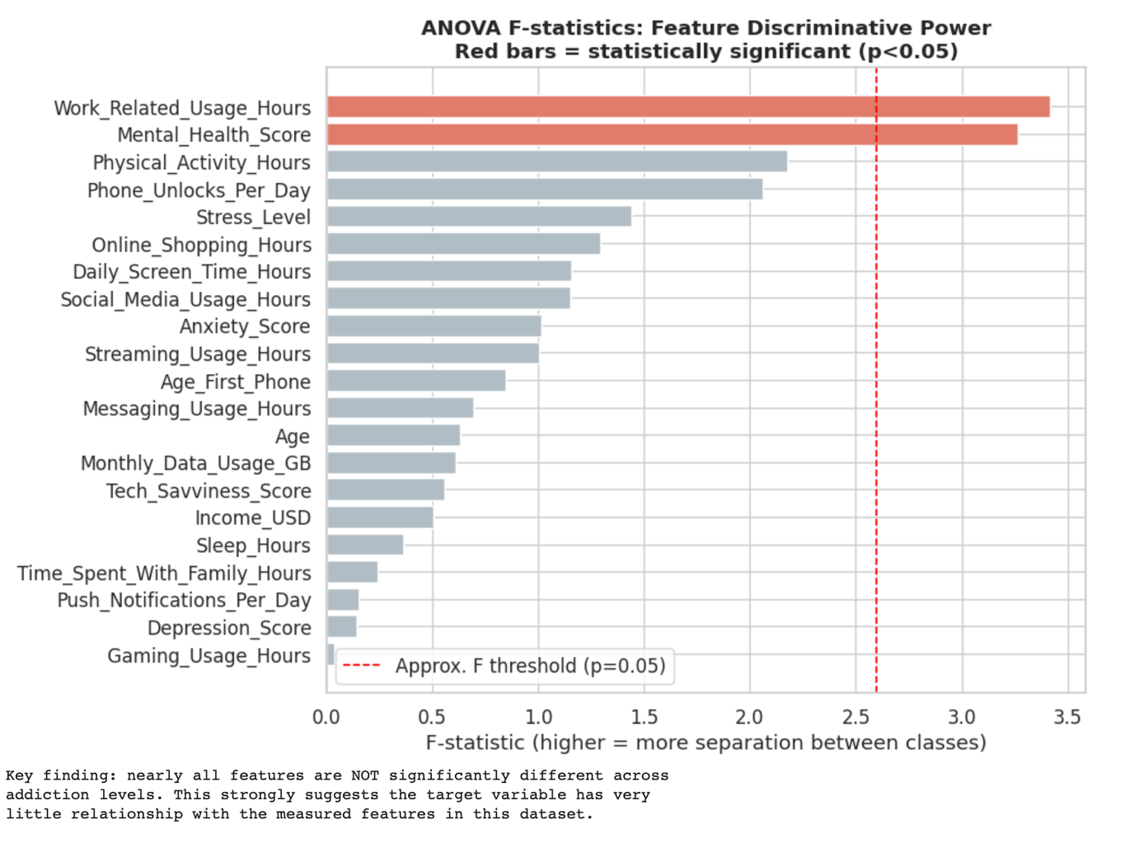
FEATURE SIGNAL ANALYSIS (ANOVA)
ANOVA analysis was applied to evaluate whether features significantly differ across addiction classes.
Most numerical features showed weak statistical separation.Only a small number of features were statistically significant.Results suggested weak feature-target relationships.

Slide 8
METHODS - MODEL SELECTION
Logistic Regression
Linear Baseline
Linear probabilistic classifier
Tells us if any linear relationship exists between
features and target
Interpretable via coefficients• max_iter = 1000 (default 100 fails after OHE expansion)
Decision Tree
Non-linear Baseline
Captures non-linear feature interactions
Direct comparison with Random Forest
max_depth = 8, min_samples_leaf = 20
Regularized to prevent overfitting on 33 features
Random Forest
Primary Model ★
Ensemble of 300 decision trees (majority vote)
Robust to noise — best for weak-signal data
n_estimators=300, min_samples_leaf=10,
max_features=sqrt
Most appropriate given ANOVA showed near-zero
signal
Why NOT KNN or SVM?
KNN: After one-hot encoding, feature space expands to 60+ dimensions → distance metrics become unreliable (curse of dimensionali ty)
SVM: Computationally expensive on 2,400+ training samples, no advantage over Random Forest under weak signal

Slide 9
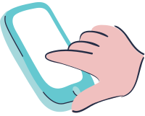
METHODS - HYPERPARAMETER JUSTIFICATION
Logistic Regression
Decision Tree
Random Forest
max_iter = 1000
max_depth = 8
n_estimators = 300
Default 100 fails to converge after one-hot encoding expands the feature space
Prevents extreme overfitting across 33 features
More trees = more stable averaging on noisy data
min_samples_leaf = 20
min_samples_leaf = 10
C = 1.0 (tuned)
Ensures each leaf is statistically meaningful, not just noise
Regularizes individual trees to reduce overfitting
Regularization strength; tuned via
RandomizedSearchCV over U(0.001, 10)
min_samples_split = 5 (tuned)
max_features = sqrt
Controls when a node is split further
Each split considers √n features — ensures tree diversity

Slide 10

EXPERIMENTS - FEATURE ENGINEERING
total_app_hours
Formula:
Sum of all app-category hour columns
Rationale:
Captures total app-mediated screen exposure as a single aggregate, rather than relying
on any single app category. A high sum signals heavy overall usage.
usage_diversity
Formula:
#non-zero app categories / total app categories
Rationale:
Measures whether usage is concentrated in one app (low diversity → possibly
compulsive behavior) or spread across many apps (high diversity → general use)
screen_to_sleep_ratio
Formula:
Daily_Screen_Time_Hours / (Sleep_Hours + 0.1)
Rationale:
Quantifies trade-off between screen exposure and rest. +0.1 prevents division-by-zero.
Excessive ratios are a clinical marker of problematic phone use.

Slide 11
EXPERIMENTS
Preprocessing Pipeline
Evaluation Strategy
Drop User_ID Row identifier — not a feature
Clip negatives to 0 e.g. negative screen time — data error
Mode impute Education_Level ~20% missing values
Median impute numericals Robust against outliers
StandardScaler Zero mean, unit variance (for LR)
OneHotEncoder Categorical → binary columns
Add composite features total_app_hours, diversity, ratio
80/20 stratified split Test set: 600 samples
5-Fold Stratified Cross-Validation
Applied on training set (2,400 samples). Stratified = preserves class balance in each fold.
Held-out 20% Test Set
600 samples never seen during training. Final, unbiased performance estimate.
Dummy Baseline (~25.5%)
Any real model must beat this. Represents random guessing on balanced 4-class
problem.

Slide 12
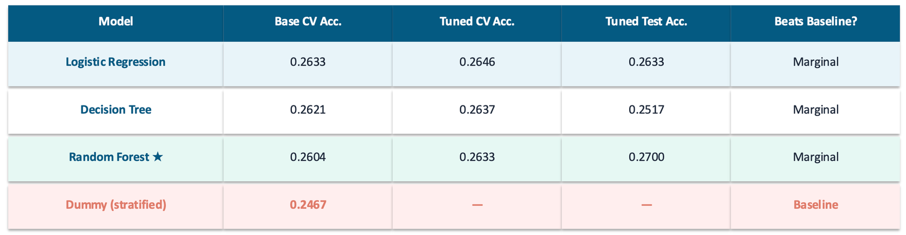
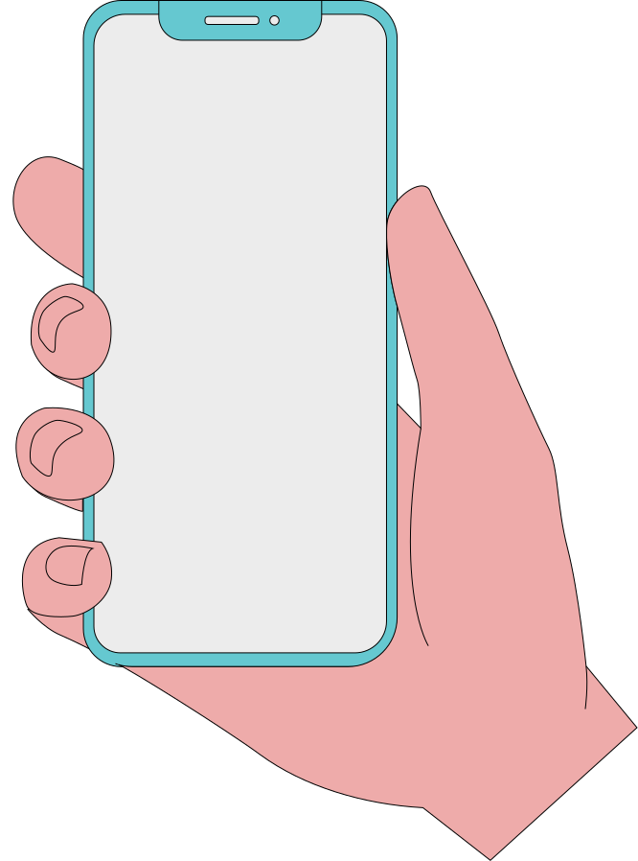
RESULTS - MODEL PERFORMANCE
Key Finding:
All three models perform near the random-chance baseline (~25.5%), even after formal hyperparameter tuning. Marginal gains of 1–2 percentage points fall within the cross-
validation standard deviation (~0.01–0.02) and cannot be attributed to genuine learning.
This is likely related to weak feature-target relationships identified during the ANOVA analysis.

Slide 13
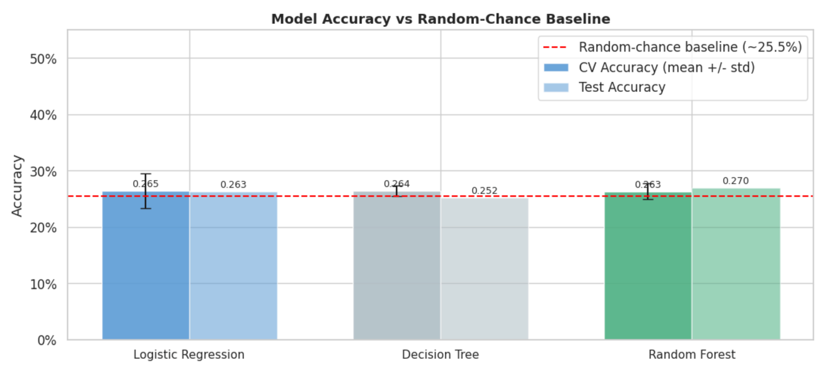
RESULTS — VISUALIZATIONS
Random Forest achieved slightly higher test accuracy, but the improvement remained marginal.
Hyperparameter tuning resulted in only marginal improvements.
All models performed close to the random-chance baseline (~25.5%).

Slide 14
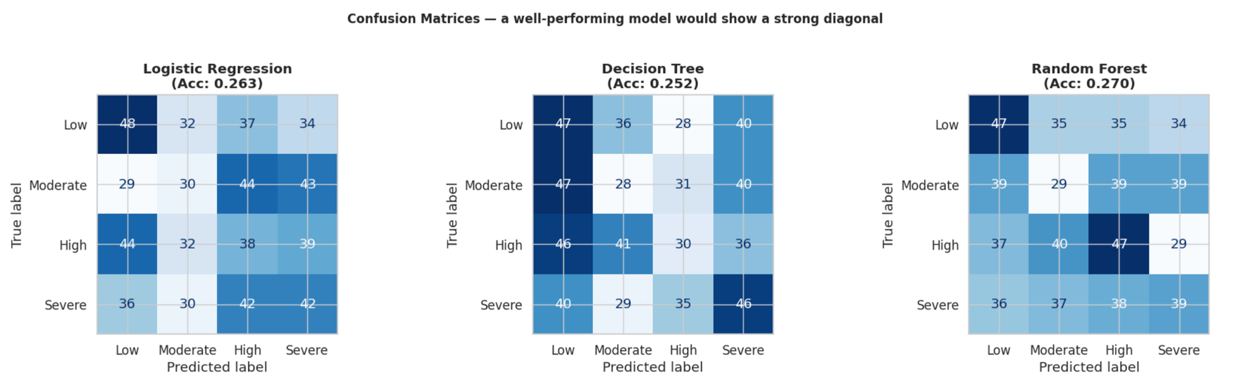
RESULTS — VISUALIZATIONS
The matrices show only a very weak diagonal pattern, while some diagonal values are slightly higher than others, the differences are too small to indicate genuine learning, as predictions remain spread across all classes.
The models struggled to reliably distinguish addiction levels.
This behavior is consistent with the low classification accuracies observed earlier.

Slide 15
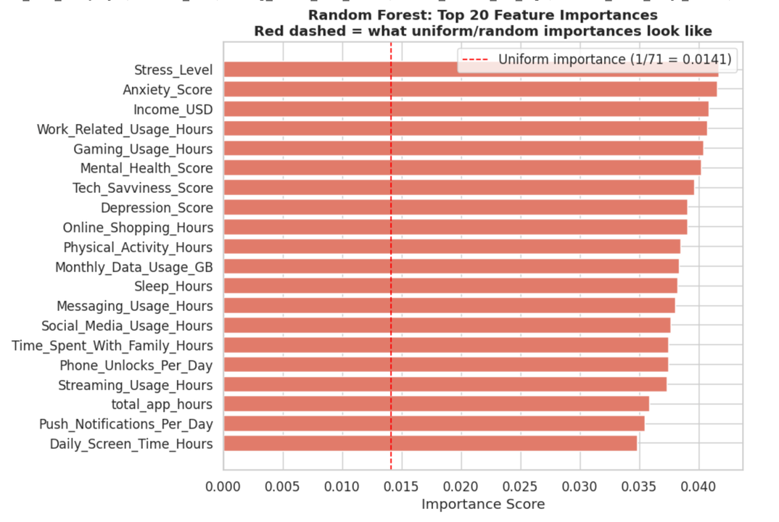
FEATURE IMPORTANCE ANALYSIS
All 20 features exceed the uniform importance baseline (1/71 = 0.0141), with scores ranging narrowly between ~0.035 and ~0.041.
No single feature stands out as dominant — the importances are spread nearly flat across all features, meaning the model could not identify any genuinely predictive signal.
The top-ranked features are Stress Level, Anxiety Score, Income USD, and Work-Related Usage Hours, yet their importance scores are only marginally higher than the rest.
This flat distribution is the fingerprint of a model trained on labels with little to no relationship to the input features.
These findings are consistent with and further support the ANOVA results, which confirmed that almost no feature significantly separates the four addiction classes.

Slide 16
CONCLUSION
Key Findings
✓ All 3 models perform at ~25–27% — near random-chance baseline
✓ Near-zero feature-target signal confirmed by ANOVA (only 2/21 features pass p<0.05)
✓ Feature importance scores spread flat — no predictive structure
✓ Pipeline and methodology are sound, limiting factor is the dataset
✓ The dataset may contain weak or unreliable label patterns.
✓ Hyperparameter tuning confirmed: gains ≤2% → within CV std dev

Slide 17

LIVE DEMO MODEL TESTING

Slide 18
THANK YOU

